Slide 1
FTIN Workflow
Declaration of Variables
Enter CIF
System Retrieves information about CIF
IF CIF is Business
Enter FTIN
Yes
No
Select Signer to Sign ACR
Esign Email To Client
WF does the Maintenance
WF Receives Document
Email Sent to User

Slide 2
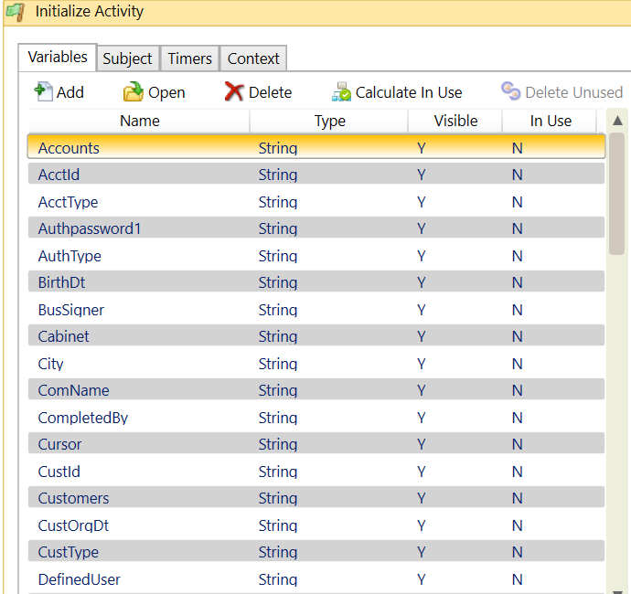
Variables

Slide 3
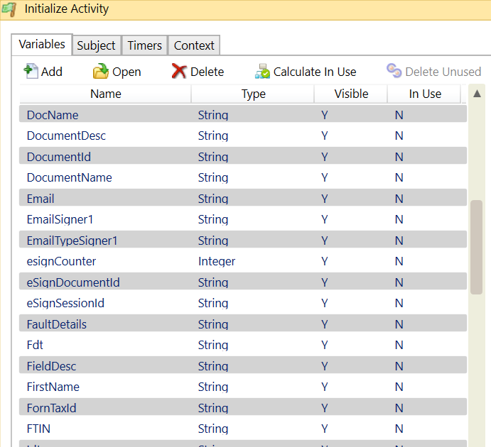
Variables

Slide 4
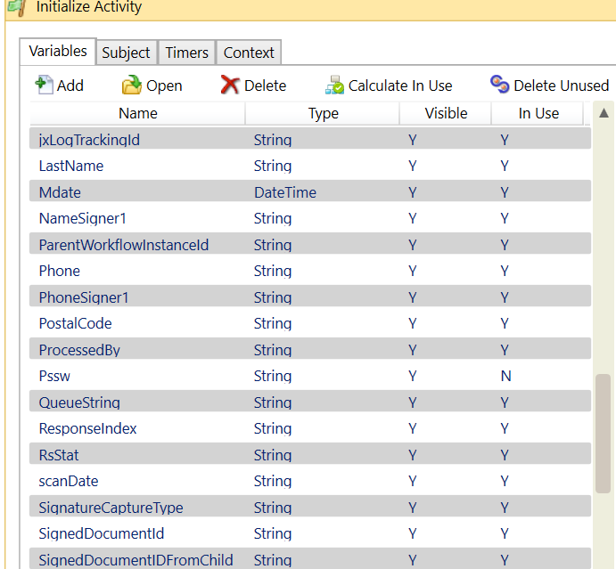
Variables

Slide 5
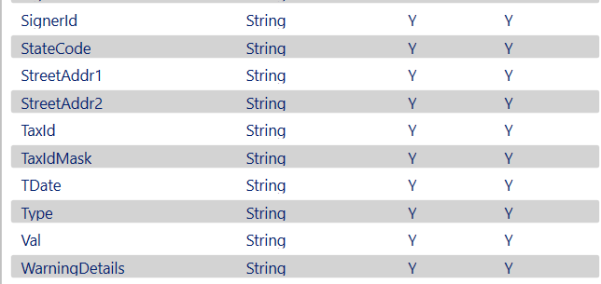
Variables

